Slide 1
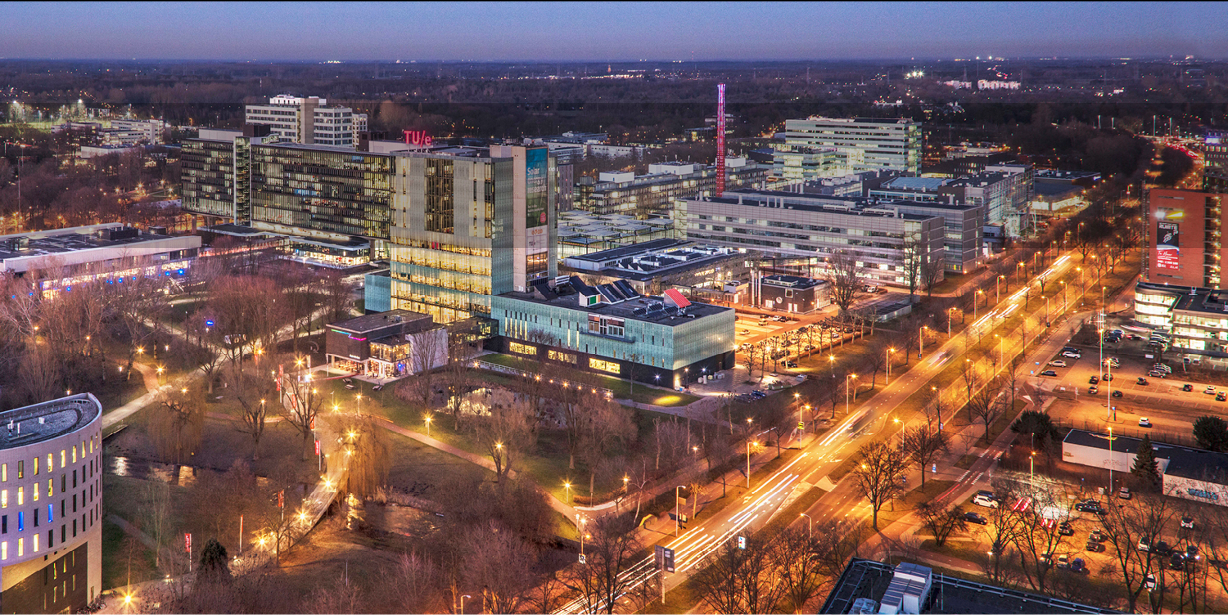

Interface characterization in SiGe/Si/SiGe multilayers
using atom probe tomography
Internship presentation 10-08-2022
Y. Baron Supervisors: J.E. Scheerder, P.M. Koenraad, C. Fleischmann

Slide 2
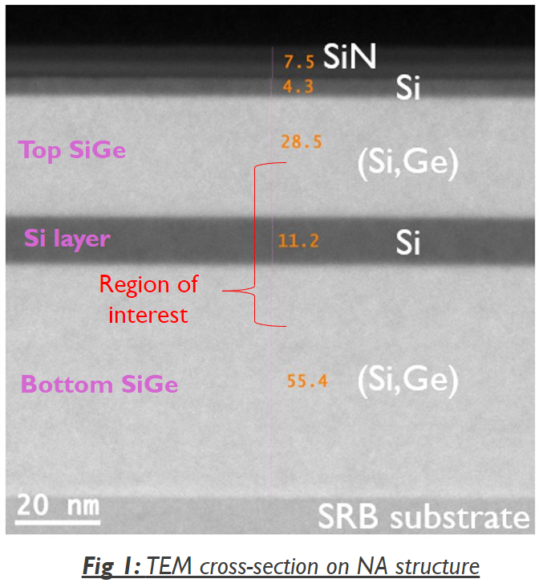

Introduction
Si is promising for development of qubits:
Well established fabrication and research
Zero nuclear spin → long spin lifetime
Qubit performance dependent on SiGe/Si interfaces
Final goal: characterize the buried interfaces using APT and link the results to the qubit performance
Determine influence of different fabrication conditions
Project goal: Evaluate the reliability of APT for interface characterization
F.A. Zwanenburg et al., Silicon Quantum Electronics, Rev. Mod. Phys. 85, 961 (2013)
public

Slide 3
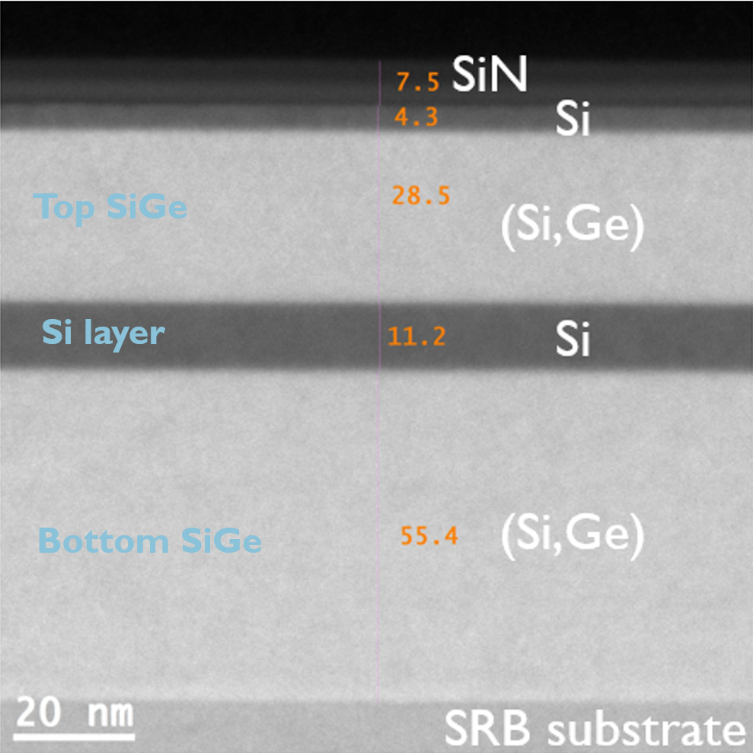
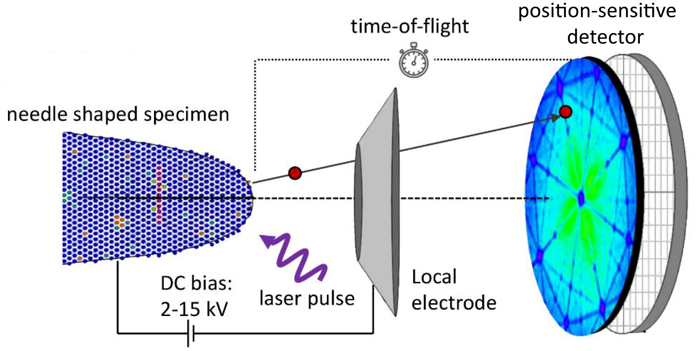
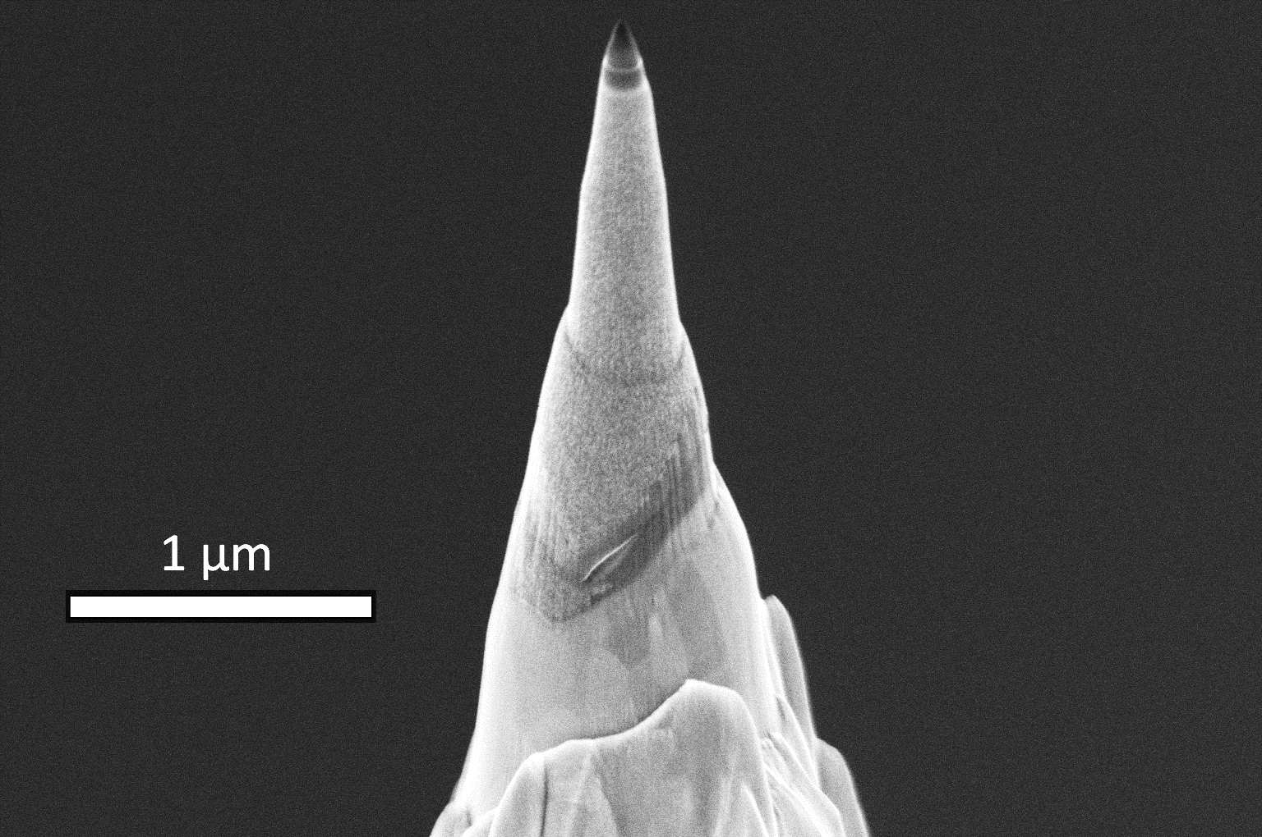
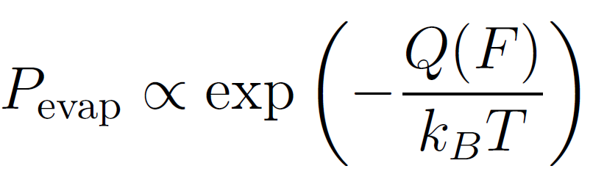
Atom Probe Tomography: Step-by-step
Sample preparation
Data acquisition
ROI
Relies on controlled field evaporation
Can measure in voltage or laser pulse mode
Hit position and sequence is recorded
Time of flight is used to identify chemical species
Image adapted from M.Dialameh Ph.D. dissertation (2019)
public
public

Slide 4
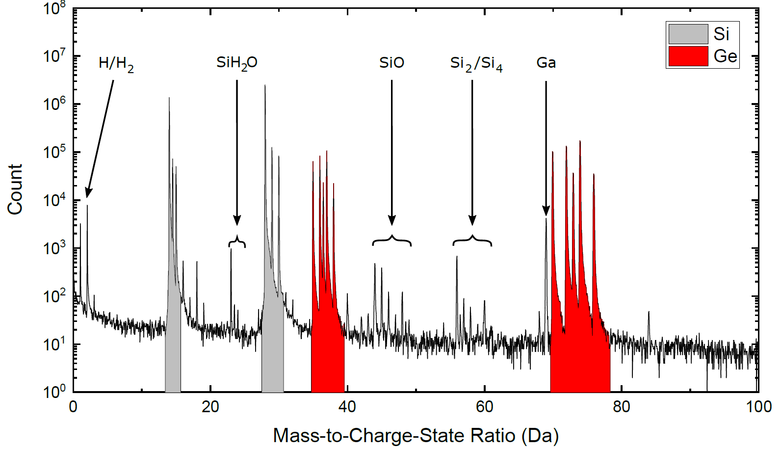
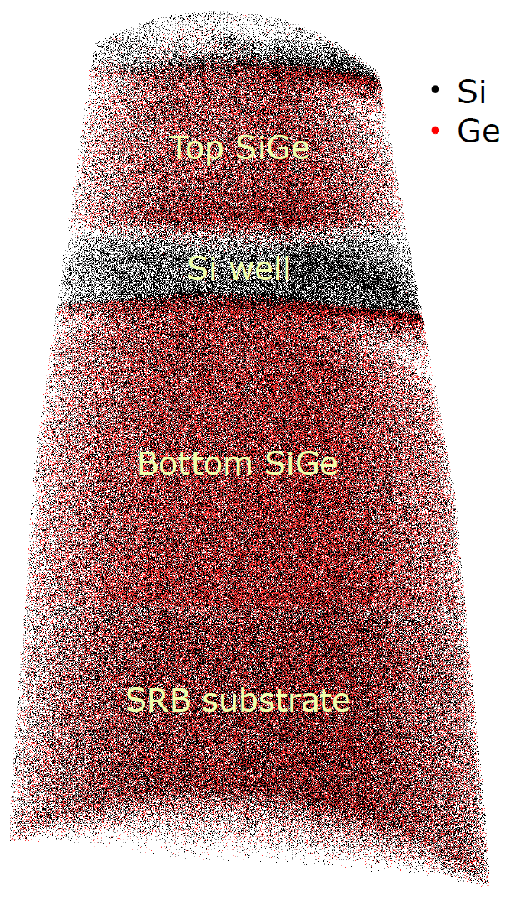
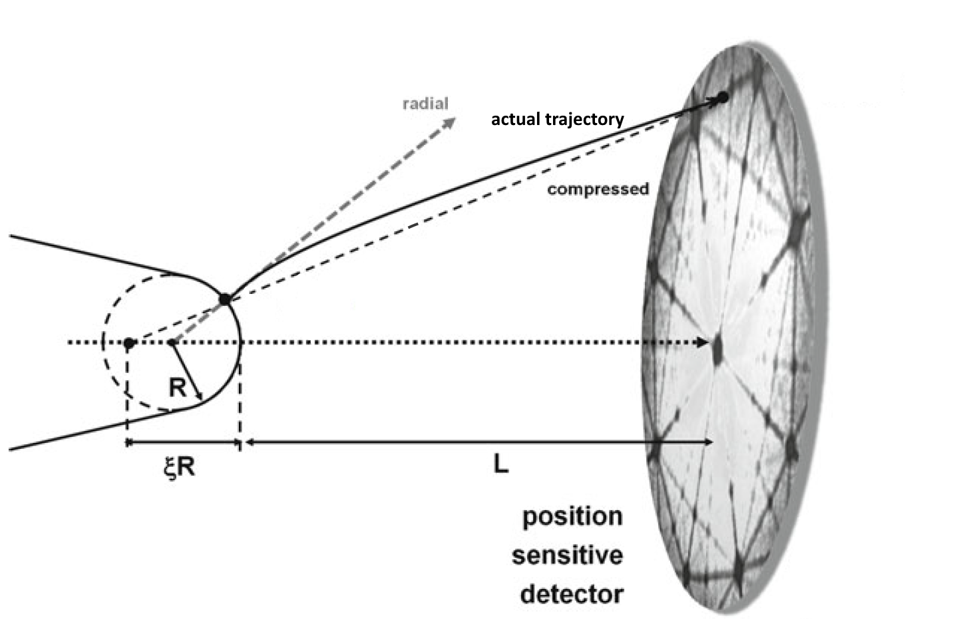
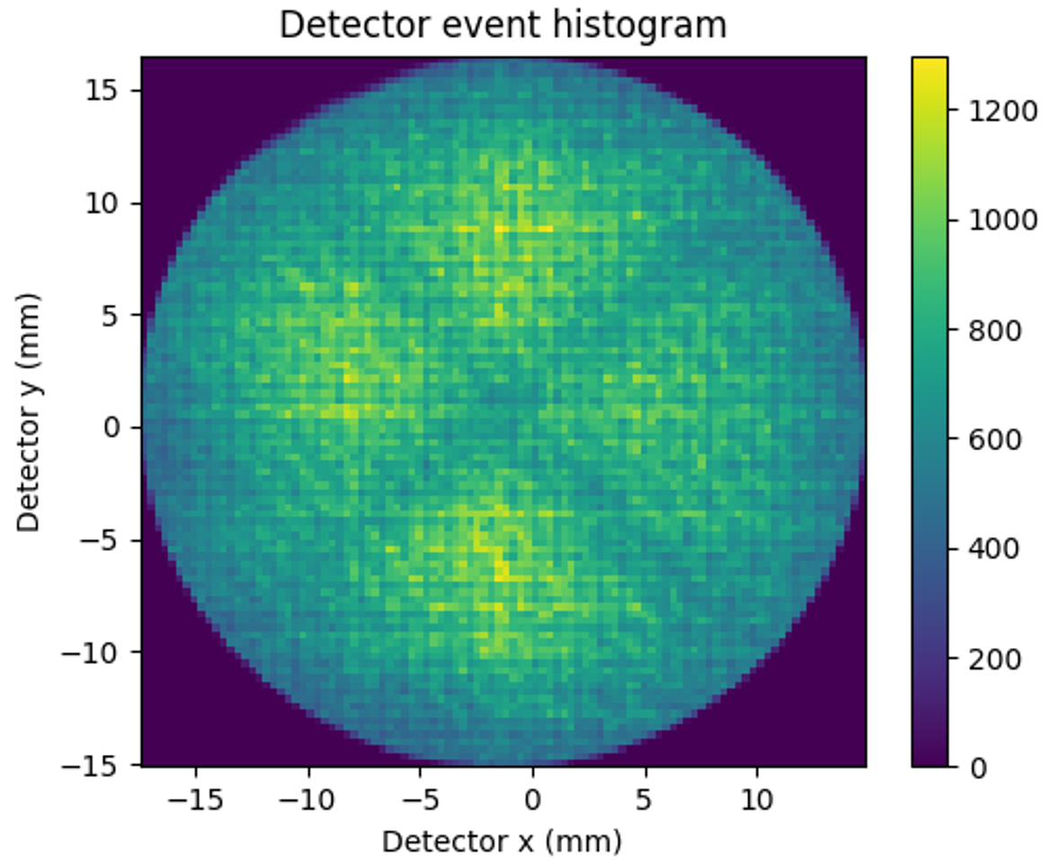
Atom Probe Tomography: Step-by-step
Chemical identification
Tomographic reconstruction
Simplified reconstruction protocol:
Field evaporation assumed from a hemispherical shell
Assumes sequence of evaporation is well controlled
Uses certain static reconstruction parameters
Detection efficiency
Image compression factor
reconstruction
Peaks can then be identified
public
Image adapted from B. Gault at al. Atom Probe Microscopy, Springer New York, vol. 160 (2012)
public

Slide 5
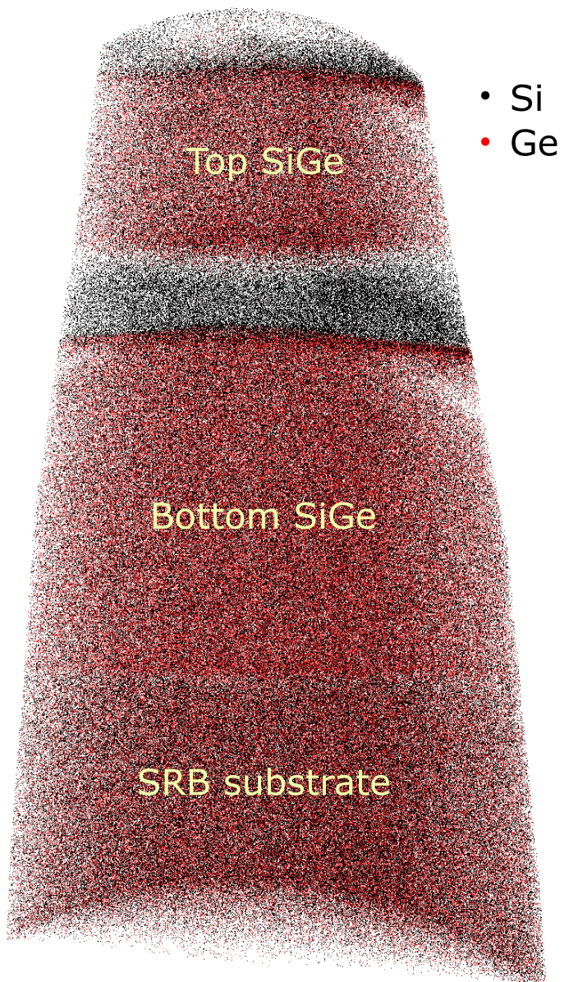
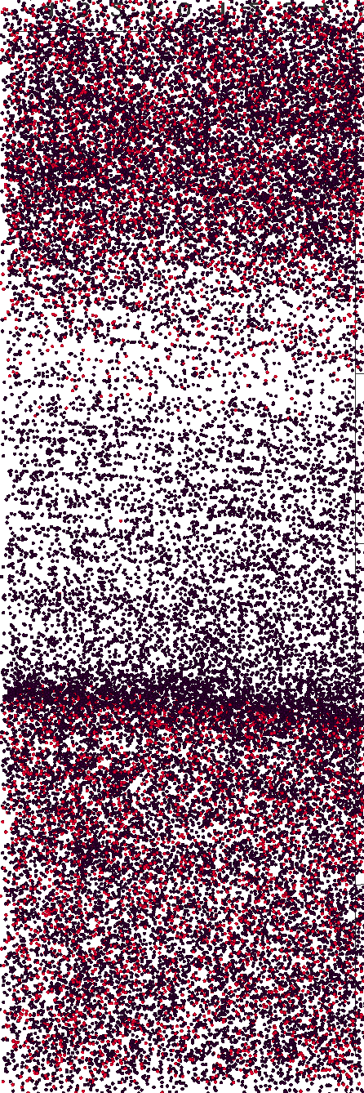
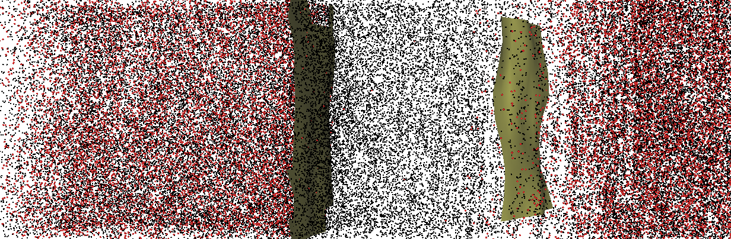
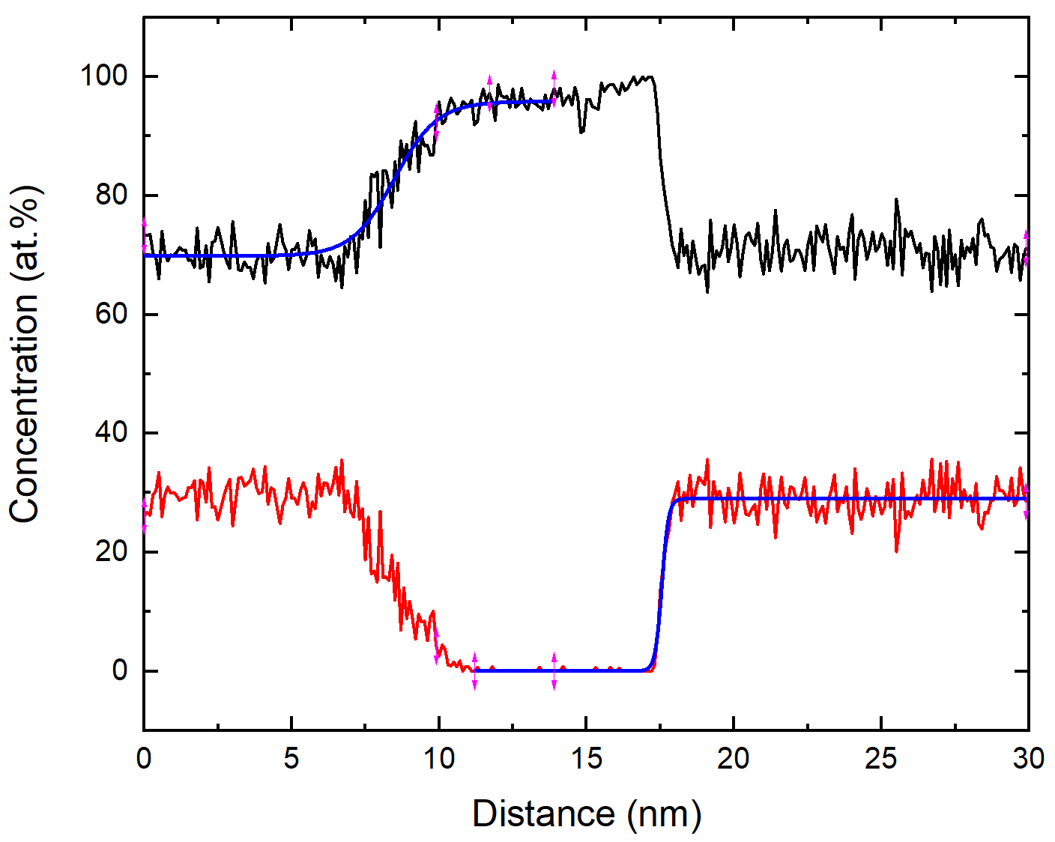
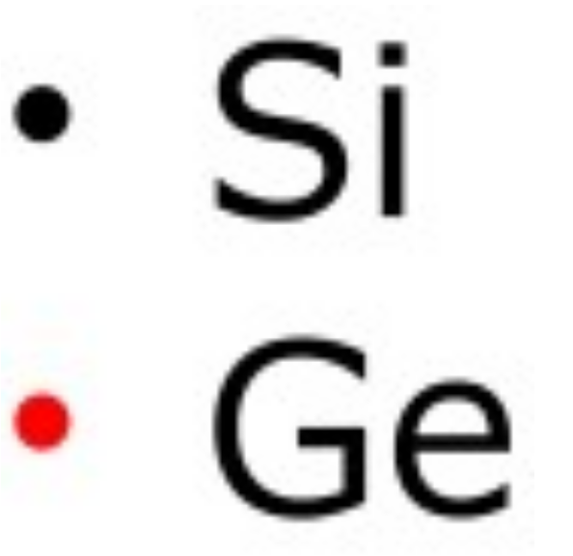
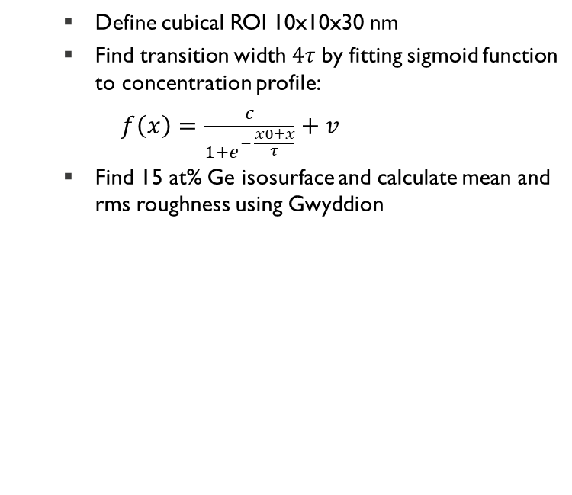
Atom Probe Tomography: Step-by-step
Interface characterization
Define cubical ROI 10x10x30 nm
Find transition width $4τ$ by fitting sigmoid function to concentration profile:
$f\left(x\right)=\frac{c}{1+e^{− \frac{x0±x}{τ}}}+v$
Find 15 at% Ge isosurface and calculate mean and rms roughness using Gwyddion
Isosurfaces
public
public

Slide 6
Contents
Reconstruction calibration (crystallography)
Identify and correct artifacts in reconstruction
Deviations while varying the ICF
Conclusion and outlook
public
public

Slide 7
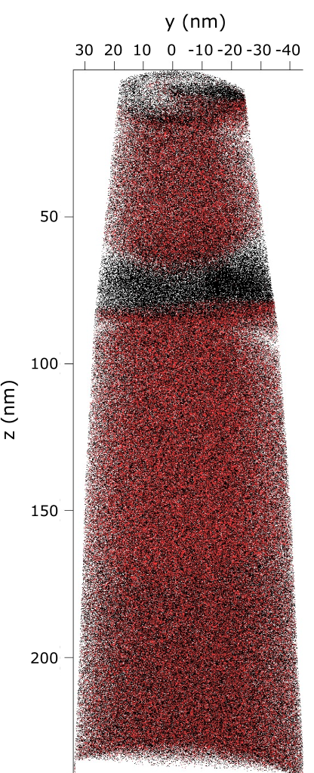
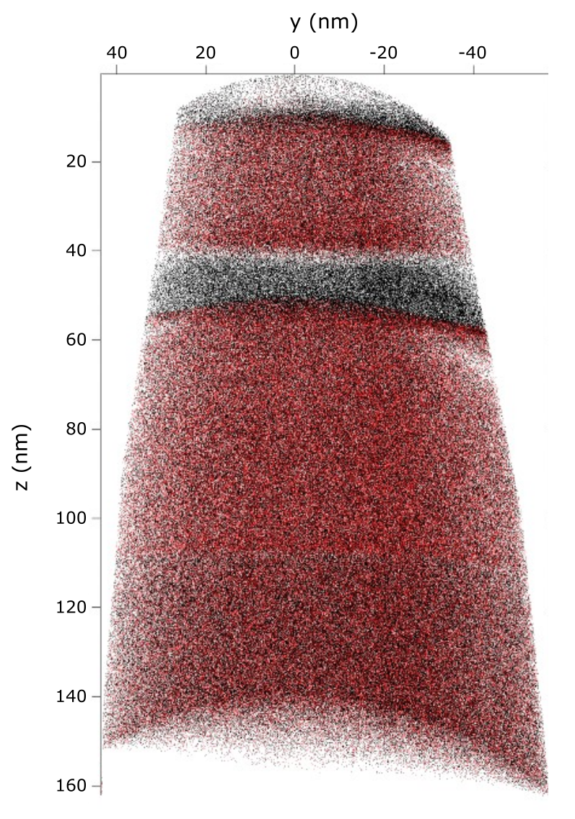
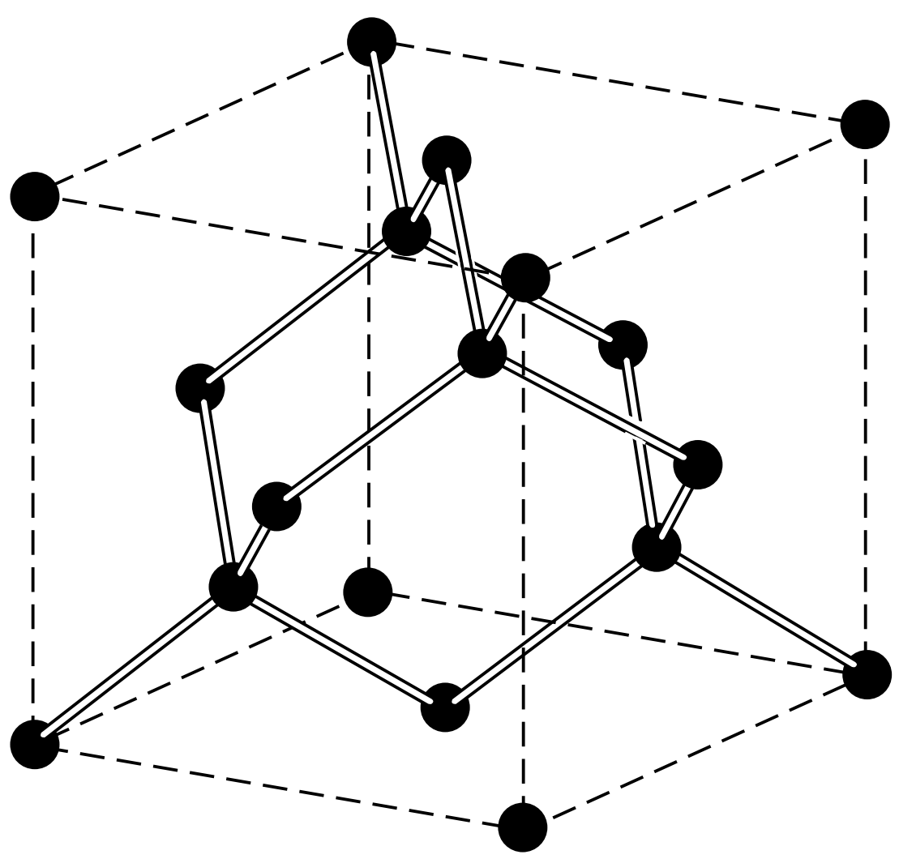
Reconstruction calibration
Use geometric information to calibrate reconstruction:
Si layer thickness
Curvature of interfaces
Crystallography?
Ge ~ 30 at%
Ge ~ 30 at%
ICF = 1.2
ICF = 1.8
C. Kittel, Introduction to solid state physics, John Wiley & Sons. (2004)
public
public

Slide 8
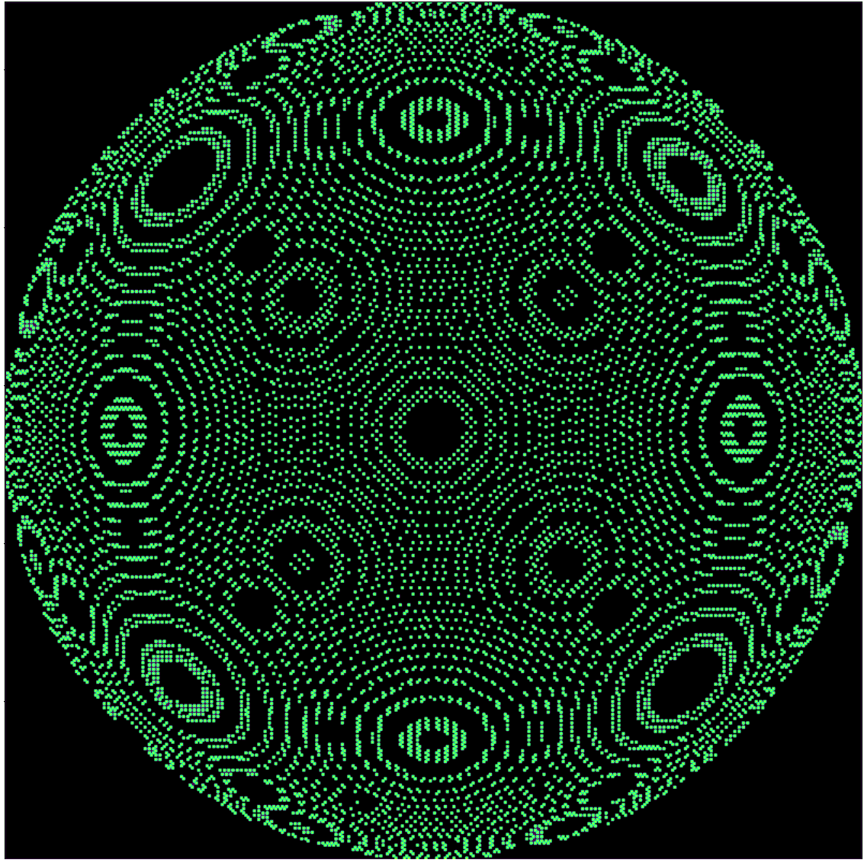
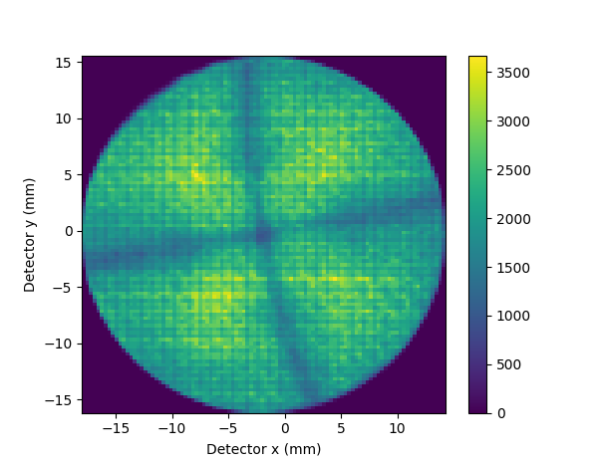
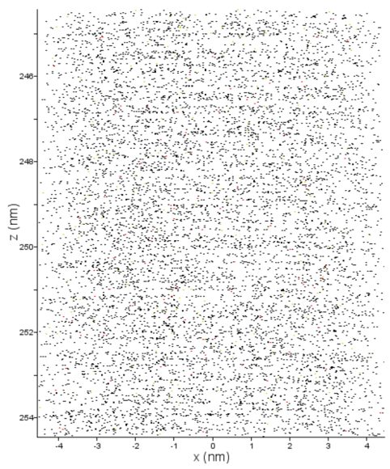
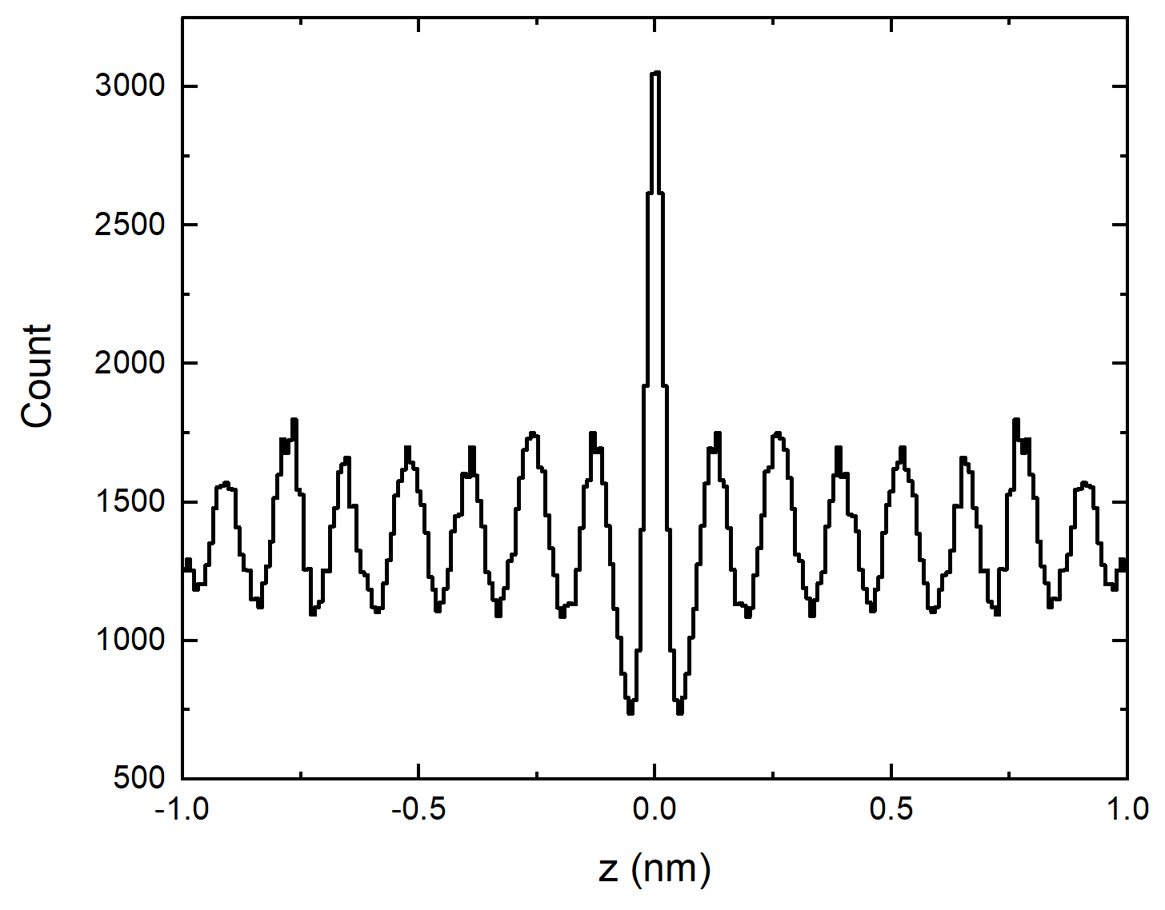
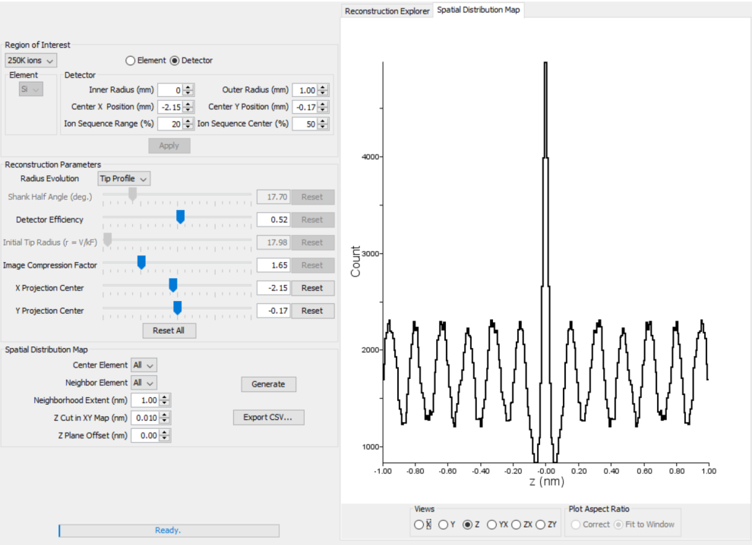
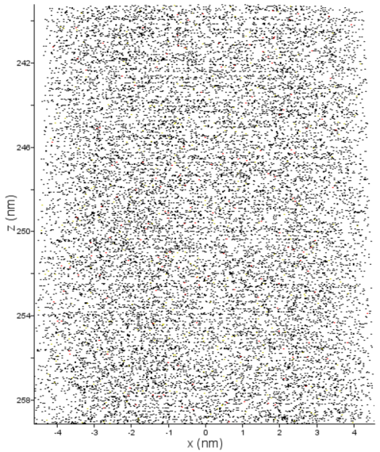
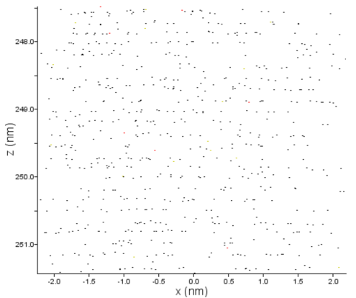
Reconstruction calibration: crystallography
Crystallographic information in APT data
Detector event histogram
Spatial Distribution Maps
Not all information on crystal structure is immediately visible:
needs extra filtering → first try on Sb-doped Si sample
Ge ~ 30 at%
Ge ~ 30 at%
public
public

Slide 9
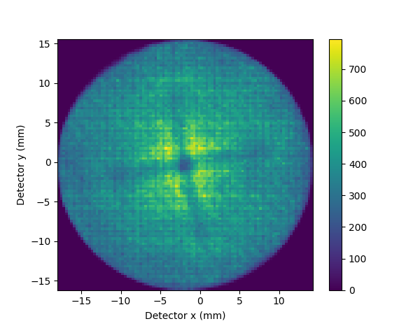
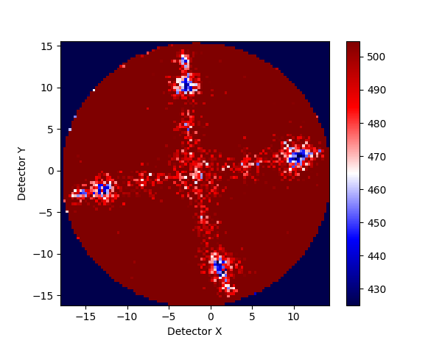
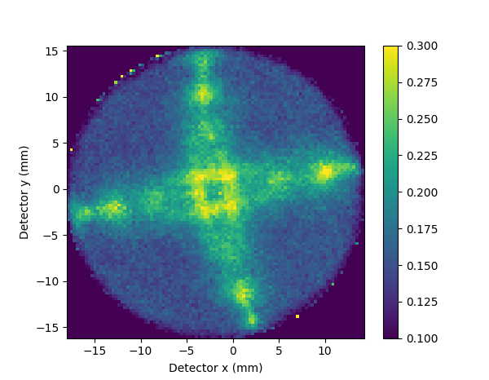
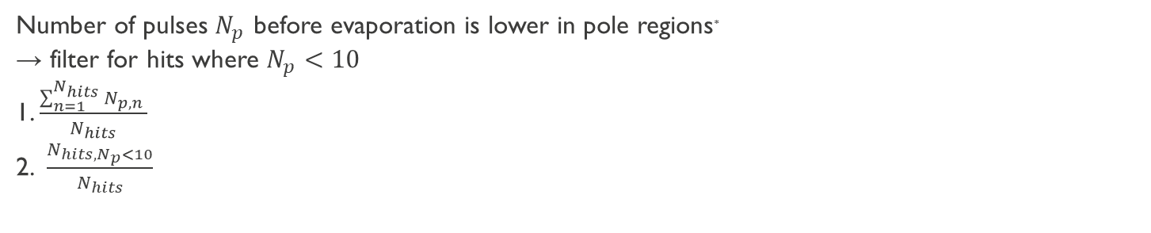
Reconstruction calibration: crystallography
Number of pulses $N_{p}$ before evaporation is lower in pole regions*
→ filter for hits where $N_{p}<10$
1. $\frac{\sum_{n=1}^{N_{hits}}{N_{p,n} }}{N_{hits}}$
2. $\frac{N_{hits,N_{p}<10}}{N_{hits}}$
1.
2.
* L. Yao, MethodsX, vol. 3, pp. 268–273 (2016), DOI:10.1016/j.mex.2016.03.012
public
public
Notes:
Say that DR is typically <1%

Slide 10
Reconstruction calibration: crystallography
Direction | Theoretical lattice spacing
<400> | 0.136 nm
<311> | 0.161 nm
public

Slide 11
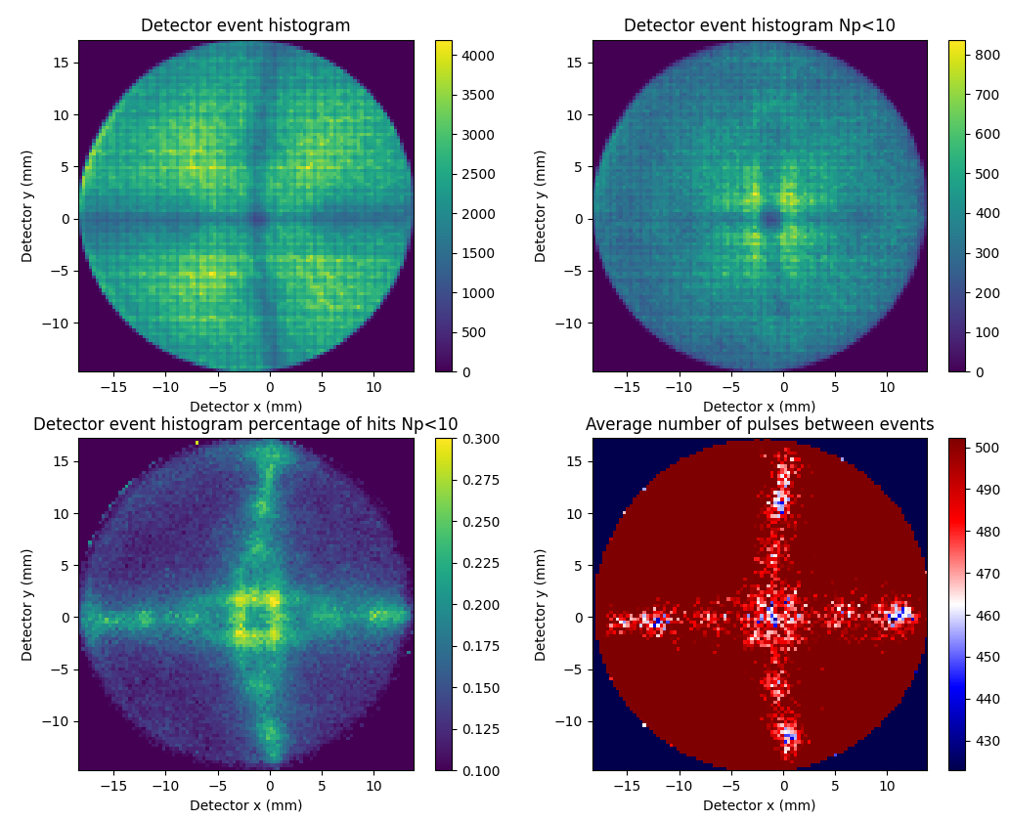
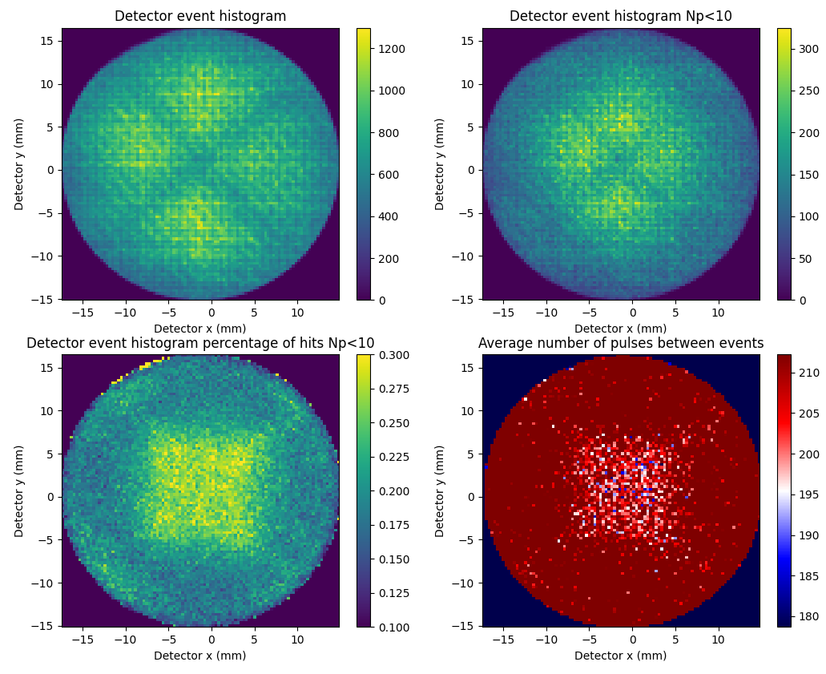
Reconstruction calibration: crystallography
Silicon
SiGe/Si/SiGe
Crystallography can be used in doped Si, but not in SiGe/Si/SiGe multilayer
→ use Si layer thickness and interface curvature
public
public

Slide 12
Identify and correct artifacts in reconstruction
Expected artifacts (related to different evaporation fields of Si and Ge):
Artificial density fluctuations
Curvature of SiGe/Si interfaces
Measure sample in two directions:
Interface characterization should be independent of direction
Evap.
dir.
Evap.
dir.
Top-down
Backside
public
public

Slide 13
Identify and correct artifacts in reconstruction
Clear density fluctuations observed
Low/high density interface depends on evaporation direction
Solution: apply a density correction
public
public

Slide 14
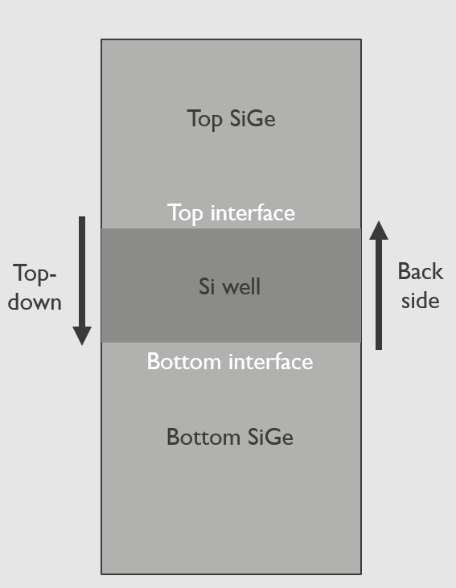
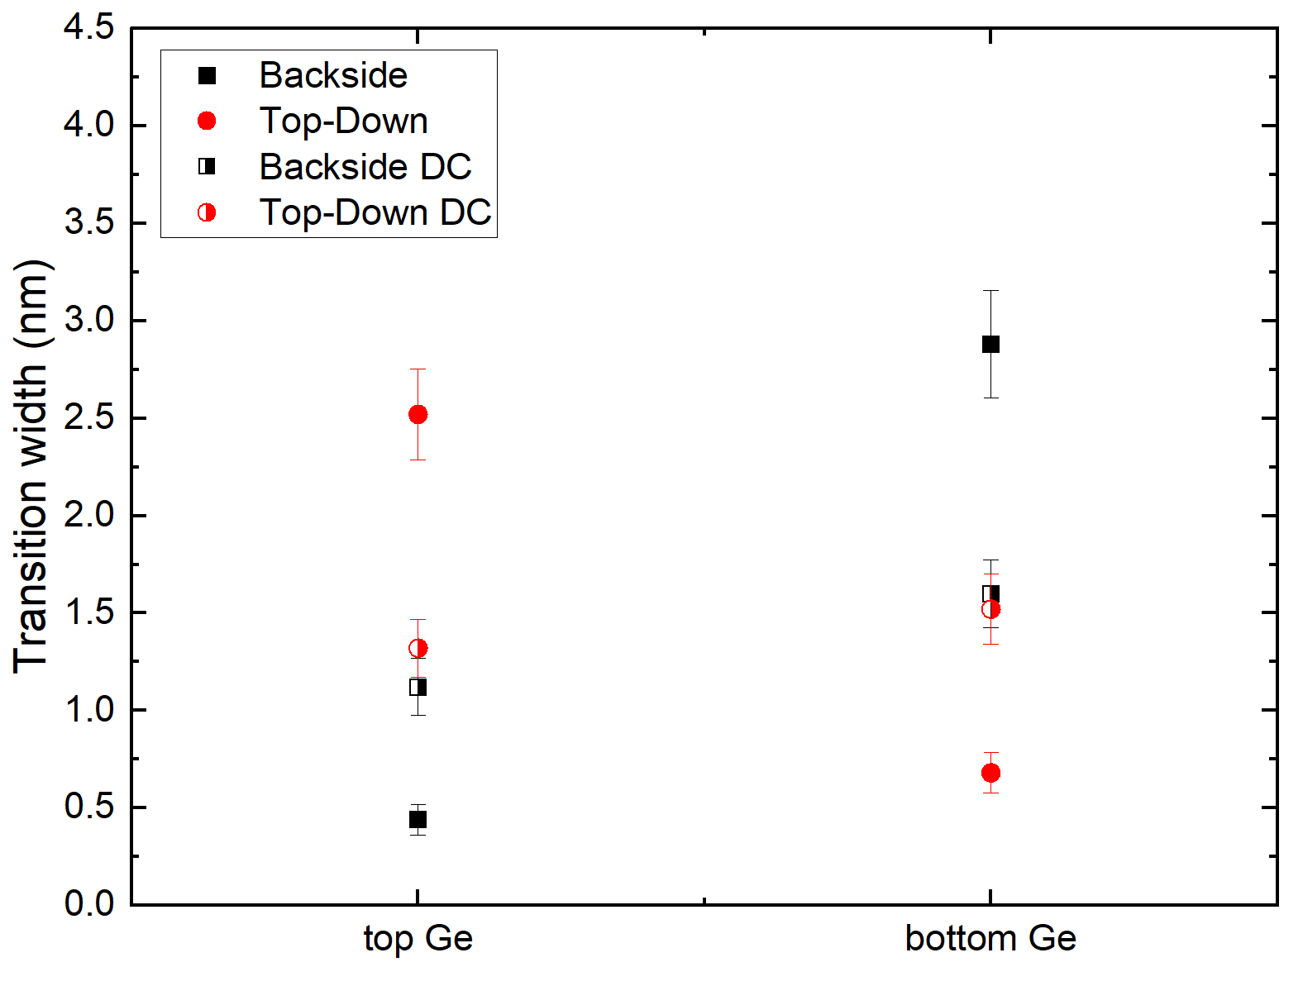
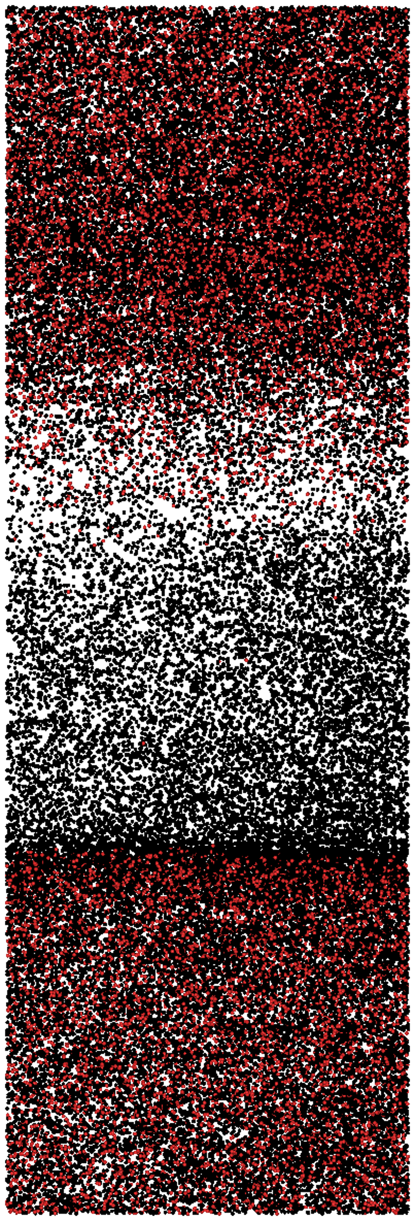
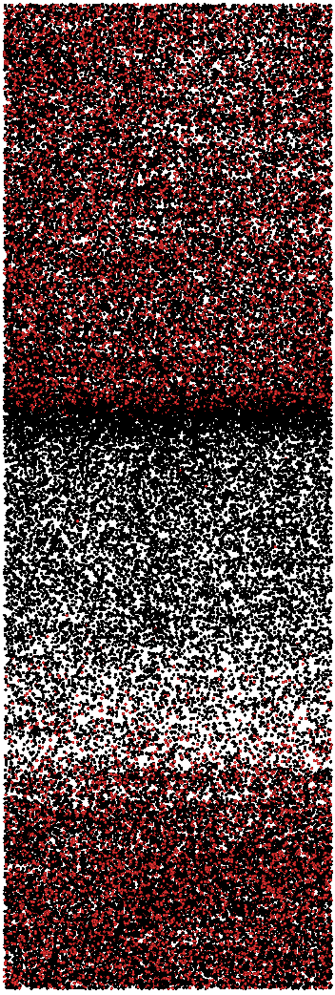
Evaluate influence artifacts on interface characterization
Low density
interface
High density
interface
Low density → larger transition width
High density → smaller transition width
Density correction reduces influence evaporation direction
public
public

Slide 15
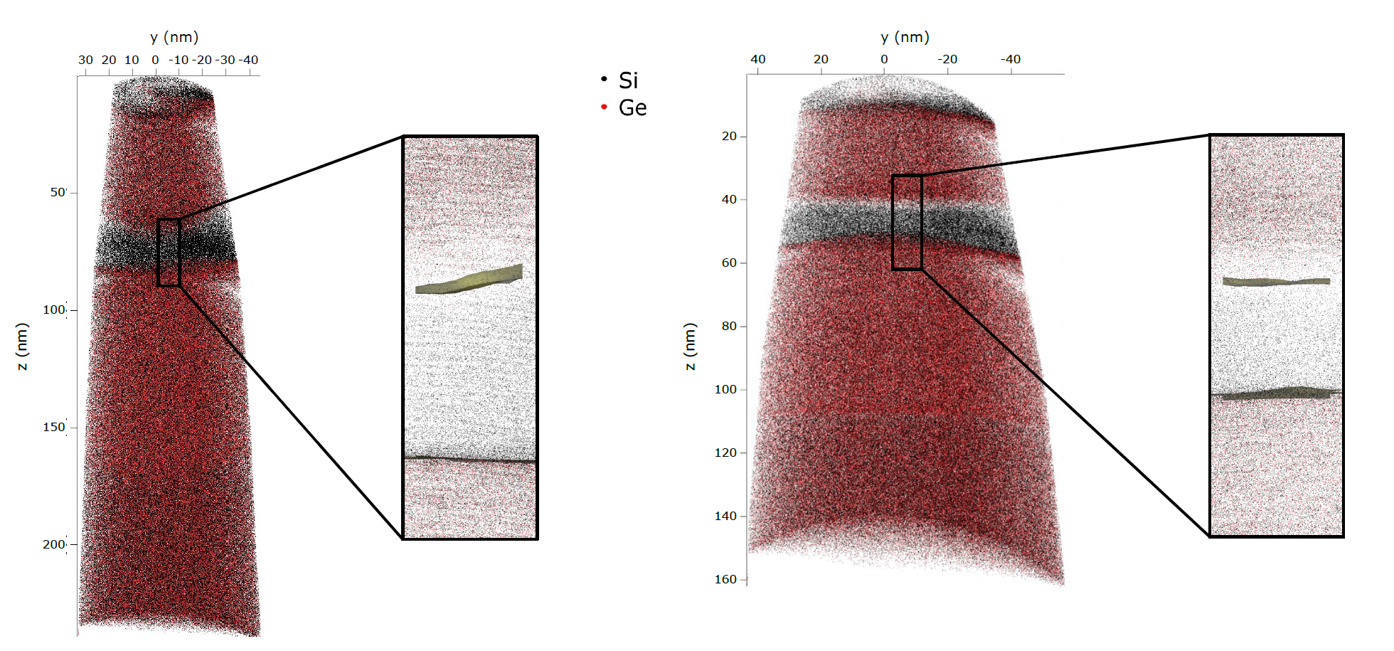
Deviations while varying the ICF
Dependence visible in isosurface
Top and bottom interface are flat for different values of the ICF
Shift induced after density correction and Si layer thickness is reduced
Similar behaviour observed in both evaporation directions (though top/bottom interface are exchanged)
ICF = 1.2
ICF = 1.8
public
public

Slide 16
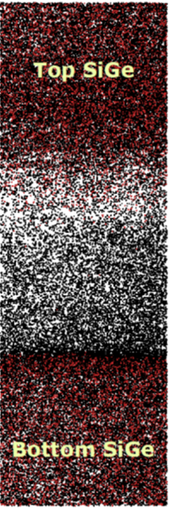
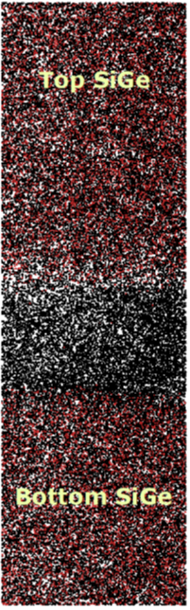
Conclusions and future work
SiGe/Si/SiGe promising platform for qubits
APT can characterize the burried interfaces
Confirm accuracy with complementary technique
Apply more complex reconstruction protocol
Check effect fabrication conditions
Bring one step closer to the quantum computer
Crystallography
Density correction
ICF variation
ICF = 1.2
ICF = 1.8
public
public

